Slide 1
Evolution of Populations
Chapter 17.1 & 17.2 (p.482-493)

Slide 2
Natural selection effects genotypes by acting on phenotypes.

Slide 3
How might the frequency of alleles within this mouse population change if…
Mice that are homozygous dominant migrated into the area.
A disease kills almost all homozygous recessive mice.
A flood carries many heterozygous and homozygous recessive mice several miles away to a new area.
How might this new population’s allele frequency differ from the original population?
The flood covers the black volcanic rock in light-colored sand.
Female mice begin to prefer males with dark coats over light coats.

Slide 4
Genetic drift can alter allele frequencies by chance.

Slide 5
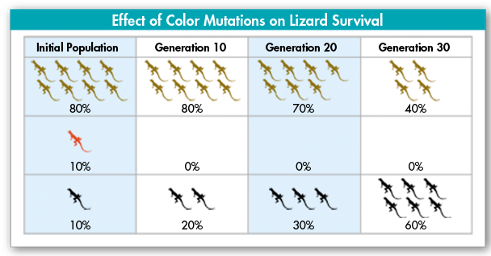
Natural selection acting on single-gene traits:

Slide 6
Natural selection acting on polygenic traits:

Slide 7
The Hardy-Weinberg principal can help us understand if a population is evolving.
No mutations
Very large population size
No gene flow
Random mating
No natural selection

